Slide 1
Chapter 8: Graphs

Slide 2
Learning Outcomes
LO5.1 Demonstrate graphs and their applications. Define an undirected graph and directed graph.
LO5.2 Explain basic notations about a graph: vertex, edge, adjacent vertices, incident edge,...
LO5.3 Know how to represent a graph using matrix and list
LO5.4 Able to apply BFS and DFS to traverse a graph
LO5.5 Write programs to implement Graph with BFS and DFS traversals using Java
LO5.6 Explain the shortest path problem and Dijkstra’ algorithm.
LO5.7 Write program in Java to implement Dijkstra’s shortest path algorithm.
LO5.8 Define the minimum spanning tree and using the Kruskal’s algorithm to find it.
LO5.9 Define Euler cycle/path and the necessary and sufficient conditions for their existence.
LO5.10 Explain the algorithm to find Euler path / circuit using Stack and implement it in Java language.
LO5.11 Define Halmilton cycle/path and able to determine them using backtracking algorithm.
LO5.12 Demonstrate the graph coloring and can apply Sequential coloring algorithm to color a graph.
P
1
P
2

Slide 3
Part 1- Contents
Discuss the following topics:
1- Introduction
2- Graph Representation
3- Graph Traversals
4- Shortest Paths
5- Cycle Detection
6- Spanning Trees – cây phủ
7- Euler, Halmilton Cycles/Paths
8- Graph coloring
Your work: Re-implement the project introduced in this lecture.

Slide 4
1- Introduction to Graphs
How to describe:
transportation road map/road network?
relations of airports?
drainage net – mạng lưới nước
country’s national electricity grid
Computer networks
…
In fact, between two objects, there exist some difference relations and each relationship need to be evaluated.
Depending on specific problem, many requirements must be solved.
Graphs

Slide 5

1- Introduction to Graphs…
Crossroad/
vertex
Road/
edge
From Google Map

Slide 6

1- Introduction to Graphs…
Node/
vertex
Connection/
edge

Slide 7
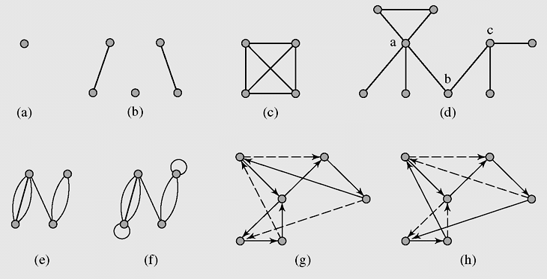
1- Introduction to Graphs…
A graph (G) is a collection of vertices (or nodes, the V set) and the connections (called as edges, the E set between them. G = { V, E }

Slide 8
1- Introduction to Graphs…
Discrete Mathematics: A undirected graph is an ordered pair G =(V, E) comprising:
V a set of vertices (also called nodes or points);
E ⊆ {{x, y} | (x, y) ∈ V² ∧ x ≠ y} a set of edges (also called arcs or links or lines), which are unordered pairs of vertices (i.e., an edge is associated with two distinct vertices).
(From Wiki)

Slide 9
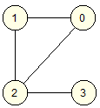
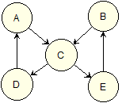
1- Introduction to Graphs…
Classification based on direction of edges:
Undirected graph / directed graph (digraph)
A directed graph, or a digraph: All edges have orientations,
vertice
vertex’s
label
edge

Slide 10
1- Introduction to Graphs…
Classification based on number of edges between vertices
Simple graph: two distinct vertices in un-directed graph can be join atmost ONE edge
Multigraph is a graph in which two vertices can be joined by multiple edges
Pseudograph is a multigraph which allows for loops at one vertex.
If all vertices in a circuit are distinct, then it is called a cycle (loop = circuit = circle)

Slide 11
1- Introduction to Graphs…
Figure 8-1 Examples of graphs: (a–d) simple graphs; (c) a complete graph K₄; (e) a multigraph; (f) a pseudograph; (g) a circuit in a digraph; (h) a cycle in the digraph

Slide 12
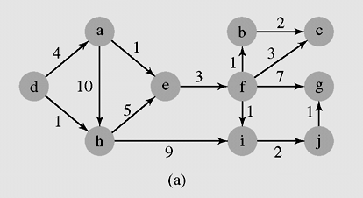
1- Introduction to Graphs…
Classification based on whether or not edges are evaluated
Weighted graph if each edge has an assigned number (property of each edge)
Un-weighted graph

Slide 13
1- Introduction to Graphs…
Degree of a vertex – Bậc của đỉnh
In undirected graphs: Degree of a vertex, (deg(v), is number of edges connecting with it.
In directed graph:
In-degree (bậc vào),(deg⁺(v), is number of edges connected to a vertex.
Out-degree,(deg⁻(v), : is number of edges connected from a vertex.
deg(v) = deg⁺(v) + deg⁻(v)

Slide 14
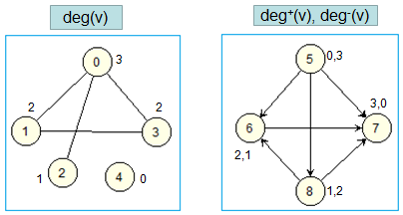
1- Introduction to Graphs…
Degree of a vertex – Bậc của đỉnh

Slide 15
2- Graph Representation
Using matrix:
adjacency matrix(ma trận đỉnh kề) or,
incidence matrix ( ma trận cạnh nối)
It requires huge memory block
Using adjacency list(danh sách kề)
Linked data structure is used to save memory.

Slide 16
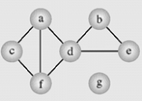
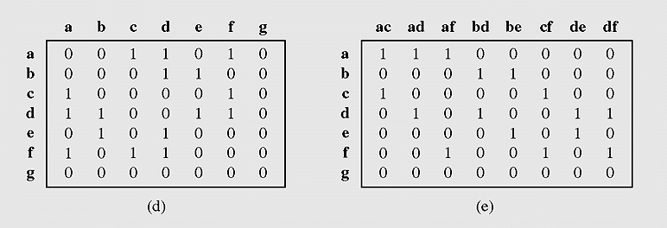
2- Graph Representation…
Vertices are sorted based on their labels
Edges are sorted based on their associations of two vetex labels
(d) an adjacency matrix
(e) an incidence matrix

Slide 17
2- Graph Representation…
Situation: Road map of a city has 10000 crossroads, and atmost 7 roads (average of 4) connecting each 2 distinct crossroads.
Using adjacency matrix:
SIZE: 10000x10000 real numbers.
In each row, there is atmost 7 positive numbers
➔ Efficiency: 7/10000
Using incident matrix:
SIZE: 10000x40000 real numbers.
In each row, there is atmost 7 positive numbers
➔ Efficiency: 7/40000

Slide 18
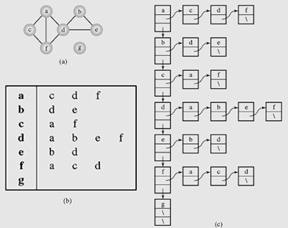
2- Graph Representation…
an adjacency list

Slide 19
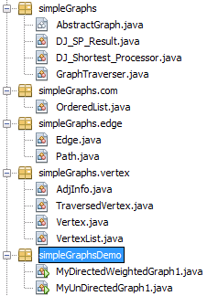
Demonstration:
Class for a general graph → Abstract graph
Class for result of shortest paths
Class implements DJ shortest path algorithm
Class for traversing a graph
Class for an ordered list (ArrayList)
Class for an edge
Class for a path including contiguous edges
Information about an adjecent ( destination, weight)
A traversed vertex (vertex, order)
Class for a vertex
Class for a list of vertices → A graph is a vertex list
A shortest path problem
A problem of graph traversing

Slide 20
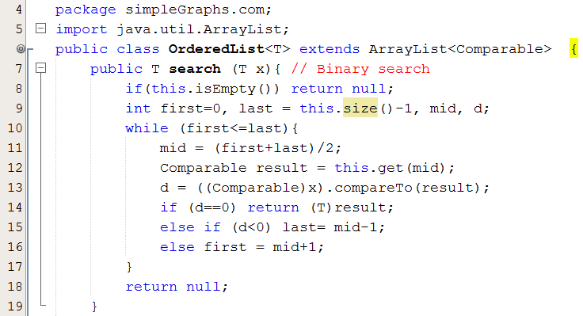

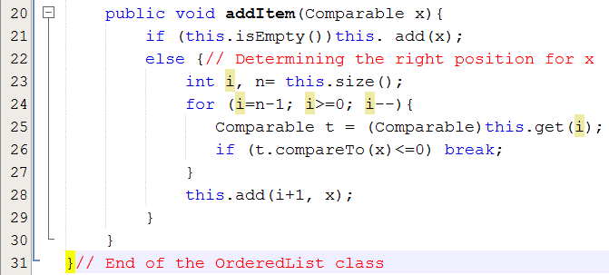
Demonstration:

Slide 21

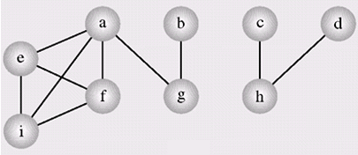
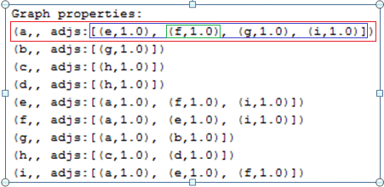
Demonstration:
OrderedList
A graph is a vertex list

Slide 22
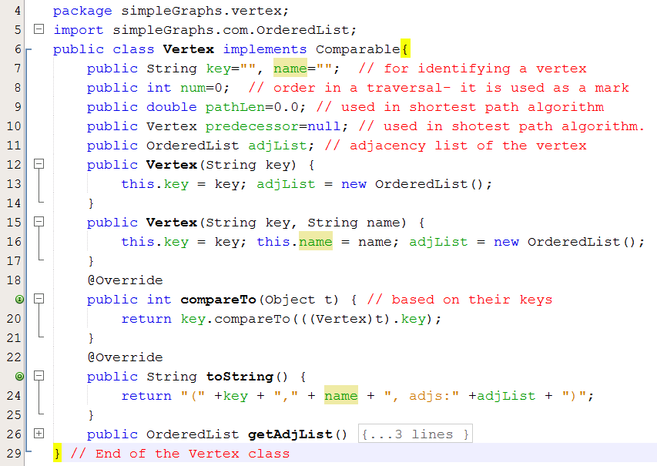
Demonstration:

Slide 23
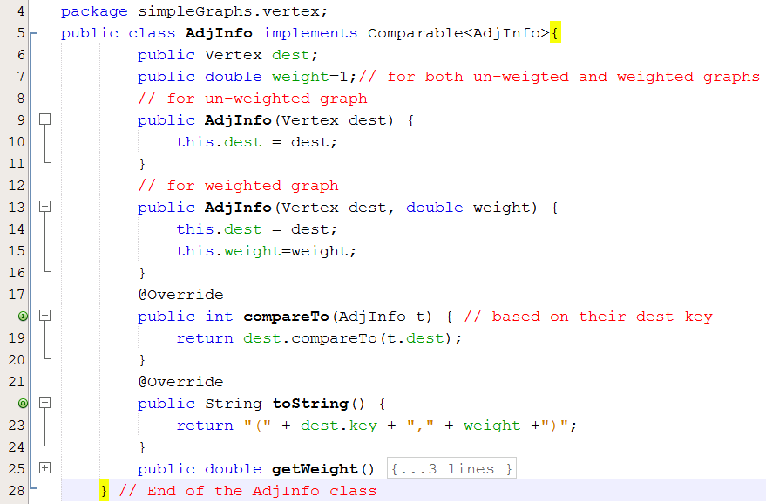
Demonstration:

Slide 24
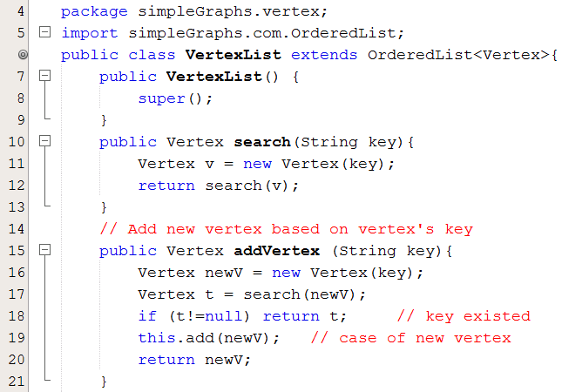
Demonstration:

Slide 25
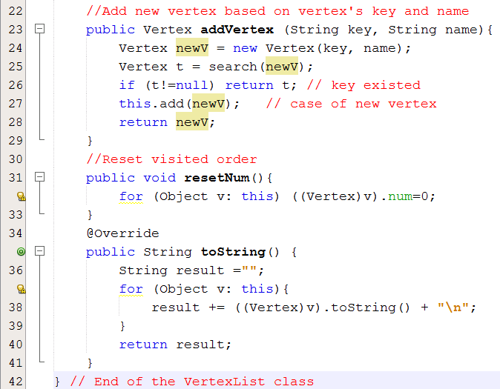
Demonstration:

Slide 26
Demonstration…
Data of graphs are commonly stored in external storage ( file, database,…) using pre-defined formats.
Operation for building a graph from external data must be implemented based on it’s format.
➔ Class for an abstract graph should be declared.
From the built graph, operations on it can perform.

Slide 27

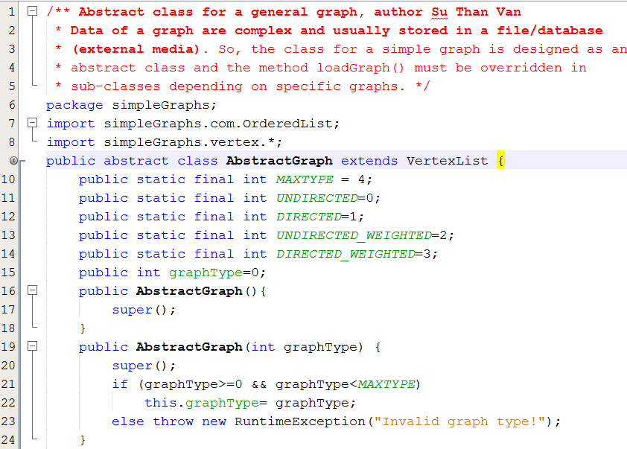
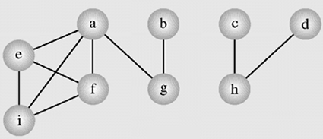
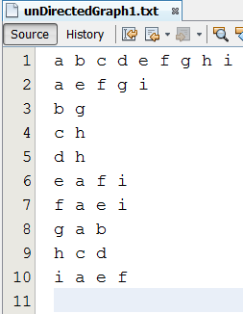
Demonstration:
Set of vertices
Adjacent information

Slide 28
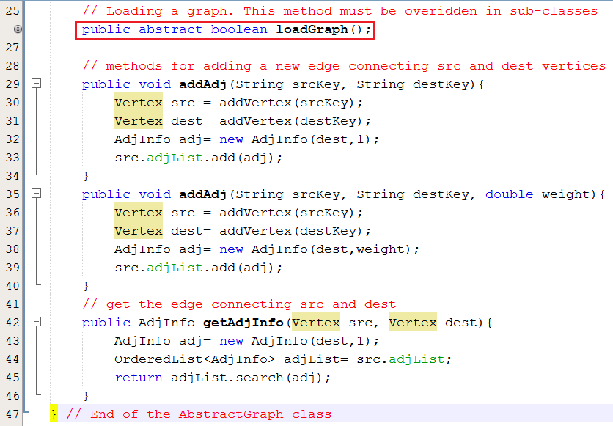
Demonstration:

Slide 29
3- Graph Traversals…
Graph traversal: An operation which will visit all vertices, each vertex will be done only one time → O(n).
Graph Traversals: They are similar as those are introduced in the chapter Trees.
Breadth-First Traversal (Breadth-First Search)
Depth- First Traversal (Depth-First Search)

Slide 30
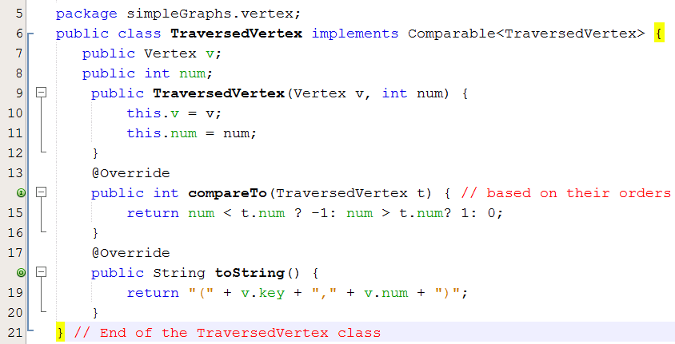
Demonstration:
2 sorting criteria:
- Vertices: Sorted by their keys.
- Traversed vertices: sorted by orders (num)

Slide 31
3- Graph Traversals…
num(v) is a positve integer which describes the visited order of the vertex v
breadthFirstSearch() // using a queue
for all vertices v num(v) = 0; // reset visited orders
i = 1; // order begin from 1
while there is a vertex v such that num(v) is 0 // Visiting all vertices
num(v) = i++;
enqueue (v)
while queue is not empty
v=dequeue();
for all vertices u adjacent to v // considering all adjacent vertices of v
if num(u) is 0
num(u) = i++;
enqueue(u);

Slide 32
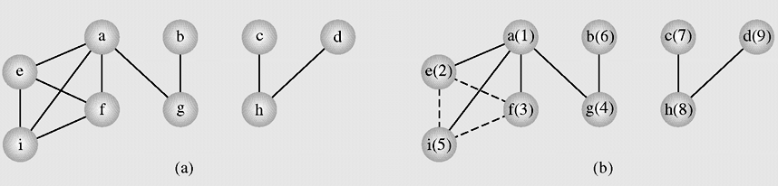
3- Graph Traversals…
breadthFirstSearch
Figure 8-5 An example of application of the breadthFirstSearch() algorithm to a graph

Slide 33
3- Graph Traversals…
Breadth First Search
Result | Queue
 | (a,1)
(a,1) | (e,2),(f,3),(g,4),(i,5)
(a,1),(e,2) | (f,3),(g,4),(i,5)
(a,1),(e,2),(f3) | (i,5)
(a,1),(e,2),(f3),(g,4), | (i,5),(b,6)
(a,1),(e,2),(f3),(g,4),(i,5) | (b,6)
(a,1),(e,2),(f3),(g,4),(i,5),(b,6) | (c,7)
(a,1),(e,2),(f3),(g,4),(i,5),(b,6),(c,7) | (h,8)
(a,1),(e,2),(f3),(g,4),(i,5),(b,6),(c,7),(h,8) | (d,9)
(a,1),(e,2),(f3),(g,4),(i,5),(b,6),(c,7),(h,8),(d,9)
a b c d e f g h i | e f g i g h h a f i a e i a b c d a e f

Slide 34
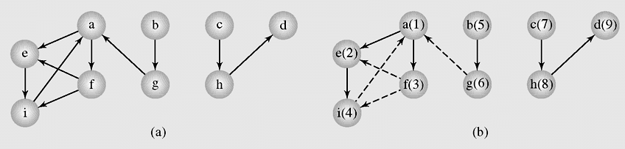
3- Graph Traversals…
breadthFirstSearch
Figure 8-6 The breadthFirstSearch() algorithm applied to a digraph
a, e, f, I, b, g, c, h, d

Slide 35
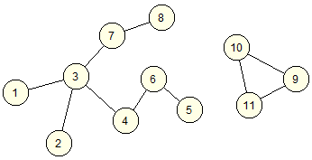
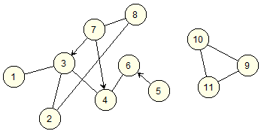
Graph Traversals…
Do yourself
Give order of vertices visited when the breadth-first search is applied.
G1
G2

Slide 36
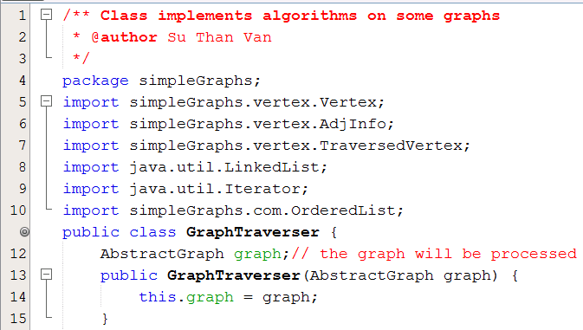

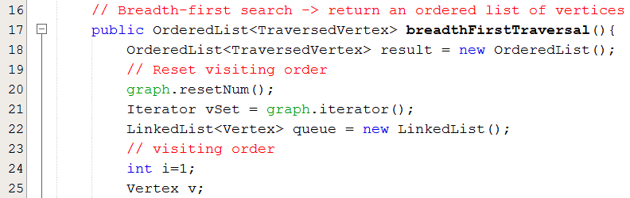
Demonstration:

Slide 37
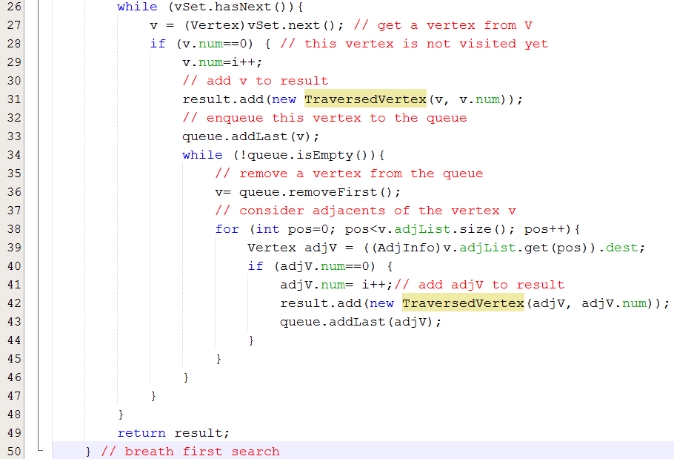

Demonstration:

Slide 38
3- Graph Traversals…
In the depth-first search algorithm, each vertex v is visited and then each unvisited vertex adjacent to v is visited
DFS (Vertex v)
num(v) = i++; // number represents the order in traversal, it marks that whether this vertex is visited nor not
for all vertices u adjacent to v
if (num(u) is 0) // this adjacent is not traversed yet
attach edge uv to edges; // update result
DFS(u); // recursive traversing down
depthFirstSearch()
for all vertices v num(v) = 0;
edges = null;
i = 1;
while there is a vertex v such that num(v) is 0 DFS(v);
output edges; // output the result

Slide 39
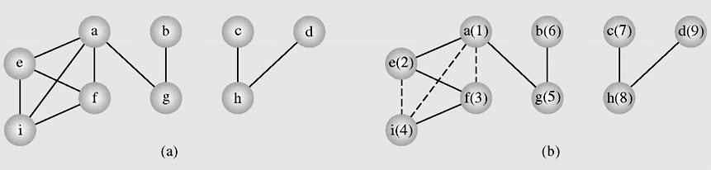
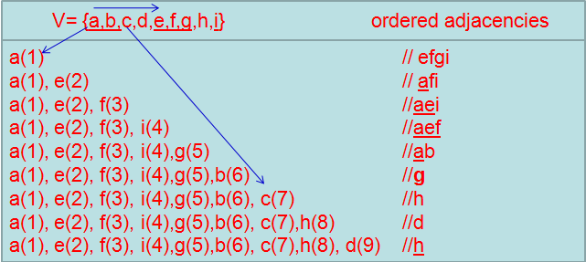
3- Graph Traversals…
An example of application of the depthFirstSearch()

Slide 40
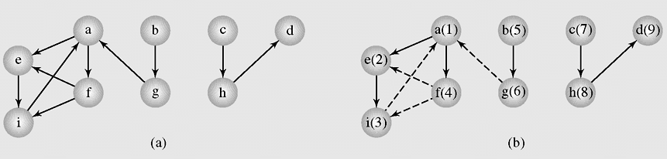
3- Graph Traversals…
Depth First Search guarantees generating a tree (or a forest, a set of trees) that includes or spans over all vertices of the original graph.
The depthFirstSearch() algorithm applied to a digraph

Slide 41
Graph Traversals…
Do yourself
Give order of vertices visited when the depth-first search is applied.
G1
G2

Slide 42
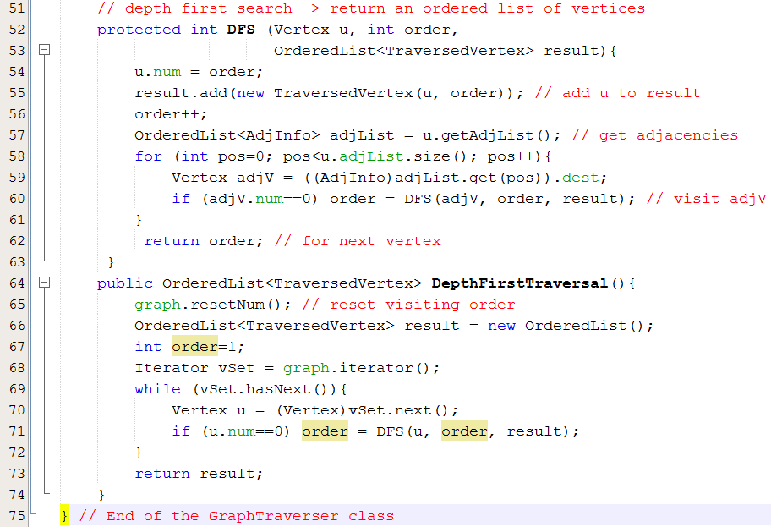
Demonstration:

Slide 43

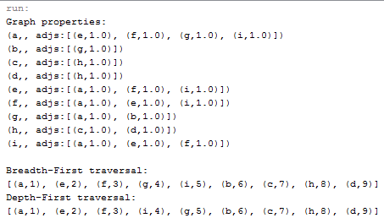
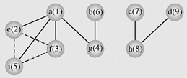
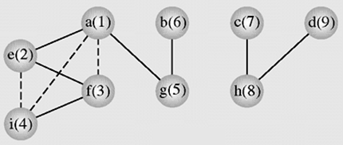
Demonstration: - A specific problem

Slide 44

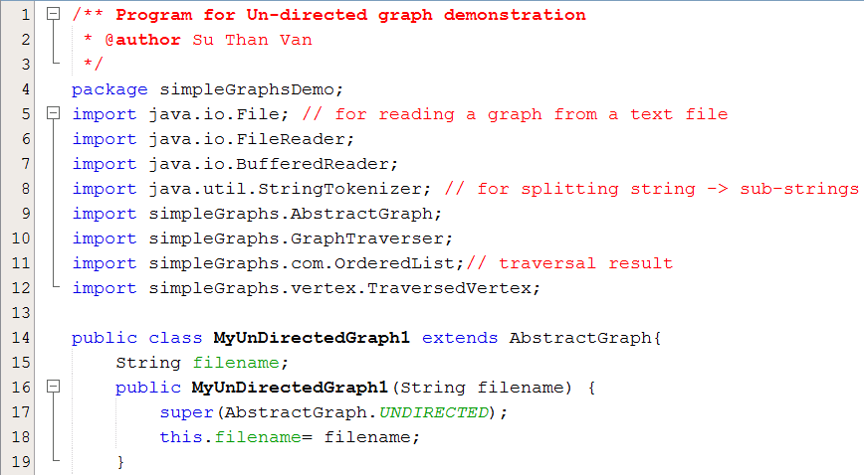
Demonstration: - A specific problem

Slide 45
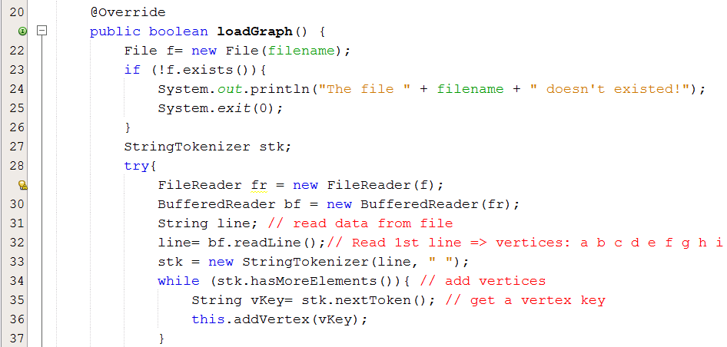
Demonstration: - A specific problem

Slide 46
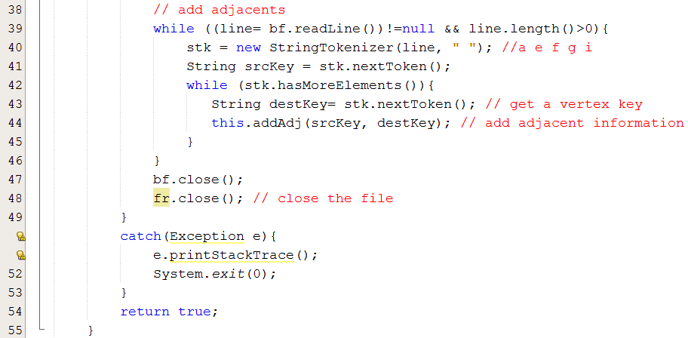
Demonstration: - A specific problem

Slide 47
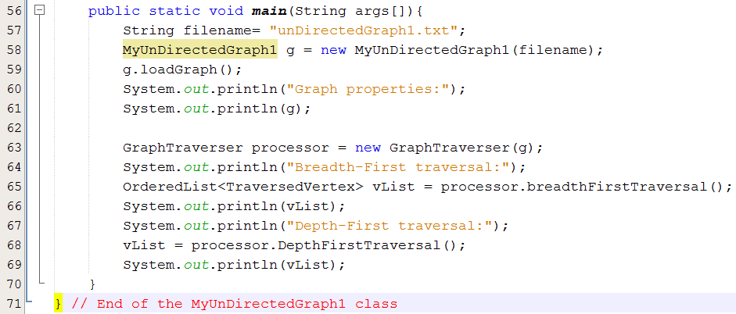
Demonstration: - A specific problem

Slide 48
8.3- Shortest Paths
Weight of an edge:
A real number which depends on specific problem.
It is positive but it may be negative in some cases.
Road map: road length (meter)
Aero map: fly length/ cost ($)
Computer network: bandwidth (bit/sec)
Drainage net: water flow (m³/s)
Electricity grid: load power (watt)
. . . .
It may be a multiple-variable function
Shortest Paths are basic requirement in Graph theory

Slide 49
8.3- Shortest Paths
Label: considered values are applied to each vertex. In this Dijkstra, introduced, Label(v) = {cost(v), predecessor(v)}
The methods solving the shortest path problem are divided in two classes:
Label-setting methods: In each pass through the vertices still to be processed, one vertex is set to a value that remains unchanged to the end of the execution
Label-correcting methods: Allow for the changing of any label during application of the method

Slide 50
8.3- Shortest Paths…
Algorithms:
Dijkstra — weight of edge >=0
Bellman-Ford — weight of edge may be negative.
A*: Using heuristics to improve performance
Floyd-Warshall — Determine shortest path for all pair of vertices.
Johnson — Determine shortest path for all pair of vertices. It can be more efficient than Floyd-Warshall on a sparce graph.
Introduced in this course
References

Slide 51

8.3- Shortest Paths…
genericShortestPathAlgorithm (weighted simple digraph, vertex first)
for all vertices v currDist(v) = ∞ (pathLen)
currDist(first)=0;
initialize toBeChecked; // set of vertices will be checked
while (toBeChecked is not empty)
v= a vertex in toBeChecked; // depending on specific algorithm
remove v from toBeChecked;
for all vertices u adjacent to v
if currDist(u) > currDist(v) + weight(edge(vu))
currDist(u) = currDist(v) + weight(edge(vu));
predecessor(u)= v;
Add u to toBeChecked if it is not there;
Label(v) = (currDist(v), predecessor(v))
Two above things open will be specified by some authors.
Dijkstra
toBeChecked= all vertices
Ford
Examine edges instead of vertices
Correction
O(|V|²)

Slide 52
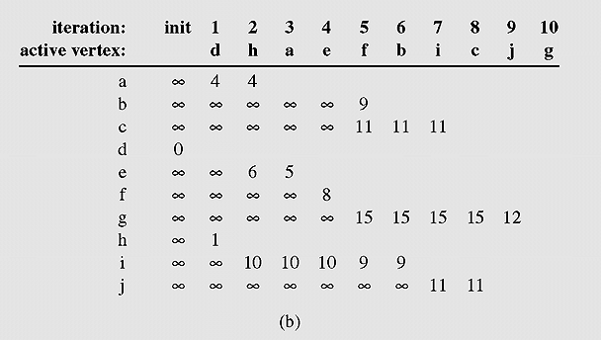
8.3- Shortest Paths…
Finding shortest paths from the vertex d to others
An execution of DijkstraAlgorithm
Độ dài đường đi ngắn nhất từ d sang i =?
Đường đi ngắn nhất từ d sang i là đường nào?
Sau bước thứ 3 của thuật toán DJ, độ dài đường đi ngắn nhất từ d đến i =? → 10

Slide 53
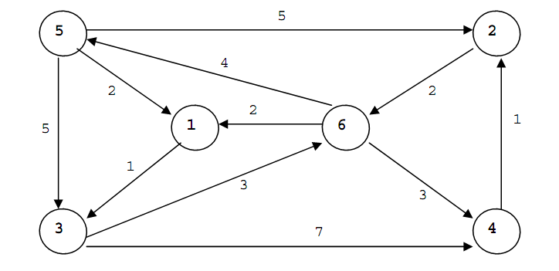
8.3- Shortest Paths…
Exercise: Use Dijkstra algorithm to find the shortest path from the vertex 5 to the vertex 4

Slide 54
8.3- Shortest Paths…
Other Algorithms: Please refer to the textbook

Slide 55
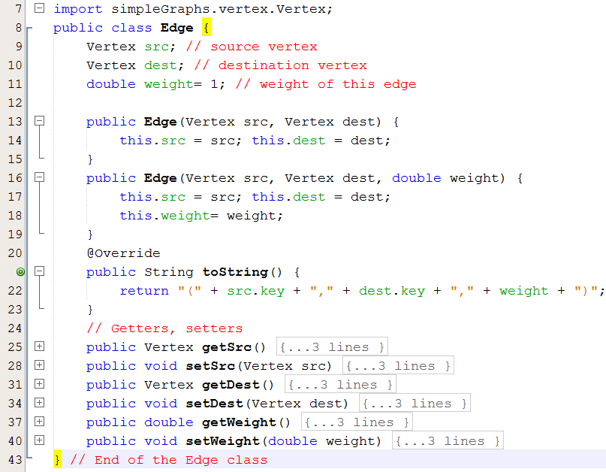
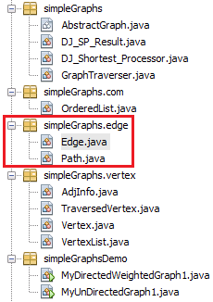
Demonstration… Classes related to Dijkstra Shortest path Algorithm

Slide 56
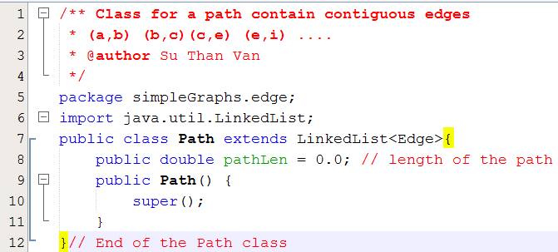
Demonstration… Classes related to Dijkstra Shortest path Algorithm

Slide 57
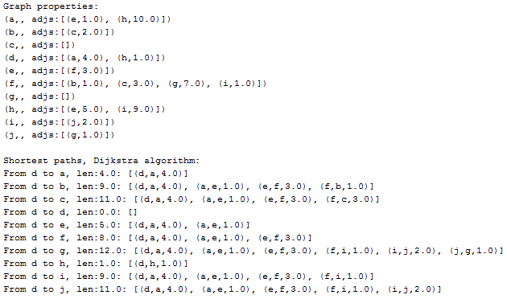
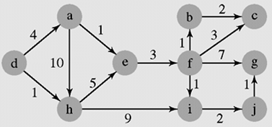
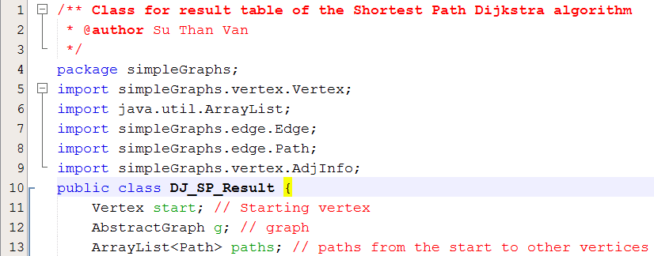

Demonstration… Classes related to Dijkstra Shortest path Algorithm

Slide 58
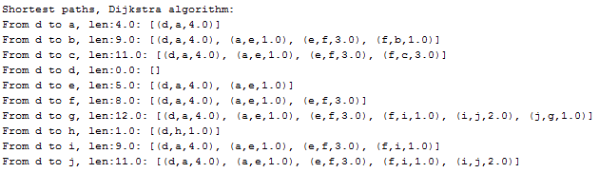
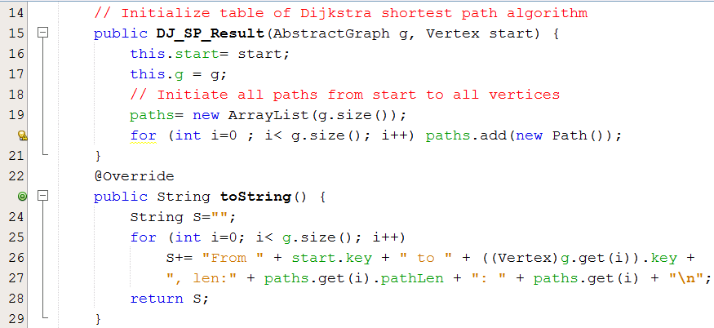
Demonstration… Classes related to Dijkstra Shortest path Algorithm

Slide 59


Demonstration… Classes related to Dijkstra Shortest path Algorithm
vertexIndex=8
dest = i
(i, f) → src = f
(f,e) → src = e, (e,a) → a, (a,d) → d

Slide 60



Demonstration… Classes related to Dijkstra Shortest path Algorithm

Slide 61


Demonstration… Classes related to Dijkstra Shortest path Algorithm

Slide 62

Demonstration… Classes related to Dijkstra Shortest path Algorithm

Slide 63

Demonstration… Classes related to Dijkstra Shortest path Algorithm

Slide 64




Demonstration…: Testing Dijkstra Shortest Path algorithm.

Slide 65


Demonstration…: Testing Dijkstra Shortest Path algorithm.

Slide 66

Demonstration…: Testing Dijkstra Shortest Path algorithm.

Slide 67

Demonstration…: Testing Dijkstra Shortest Path algorithm.

Slide 68

Demonstration…: Testing Dijkstra Shortest Path algorithm.

Slide 69

Demonstration…: Testing Dijkstra Shortest Path algorithm, result

Slide 70
8.4- Cycle Detection
Depth-First Search → Cycle Detection
DFS (Vertex v)
num(v) = i++;
for all vertices u adjacent to v
if (num(u) is 0)
attach edge uv to edges;
DFS(u);
cycleDetectionDFS (Vertex v)
num(v) = i++;
for all vertices u adjacent to v
if (num(u) is 0) // u is not visited → continue traversing
attach edge uv to edges;
cycleDetectionDFS(u);
else if edge(uv) is not in edges, cycle detected // u is re-visited → cycle
digraphCycleDetectionDFS (Vertex v)
num(v) = i++;
for all vertices u adjacent to v
if (num(u) is 0)
pred (u)= v;
digraphCycleDetectionDFS(u);
else if num(u) is not ∞
pred (u) = v;
cycle detected;
num(v) = ∞;
modify
O(n²)

Slide 71

8.5- Spanning Trees- Cây phủ
G’ (V’, E’) is called as a subgaph of the graph G(V, E) if and only if V’ is a subset of V and E’ is a subset of E.
G’ (V’, E’) is called as a spanning tree of subgaph of the graph G(V, E) if and only if V’=V and E’ is a subset of E and G’ is a tree (connected, having no cycle).
A graph may have some spanning trees.
A graph representing (a) the airline connections between seven cities and (b–d) three possible sets of connections

Slide 72
8.5- Spanning Trees…
- A graph may have some spanning trees
- In weighted graph, minimum spanning tree: a spanning tree which sum of edge weights is minimum.
How to construct minimum spanning trees?
Algorithms will be introduced:
- Krushkal (written in learning outcome)
- Dijkstra
- Prim-Jarnik

Slide 73
8.5- Spanning Trees…
Minimum spanning tree- Kruskal algorithm:
Input: weighted connected, undirected graph
Output: minimum spanning tree
tree = null;
edges = sequence of all edges of graph sorted by weight;
for (i=1; i<= |E| and |tree| < |V| -1; i++)
if e_{i} from edges does not form a cycle with edges in tree
add e_{i} to tree.
Edges having small weight are choosen with high priority

Slide 74


8.5- Spanning Trees…
Minimum spanning tree-Kruskal algorithm:
Lấy cạnh có trọng số bé

Slide 75
8.5- Spanning Trees…
Minimum spanning tree- Dijkstra algorithm:
Input: weighted connected, undirected graph
Output: minimum spanning tree
tree = null;
edges = an unsorted sequence of all edges of graph ;
for j=1 to |E|
- add e_{j} to tree;
- if there is a cycle in tree, remove an edge with maximum weight from this only cycle;

Slide 76

8.5- Spanning Trees…
Minimum spanning tree- Dijkstra algorithm:
Edges are choosen in natural order of edge abels

Slide 77
8.5- Spanning Trees…
Minimum spanning tree-
Prim-Jarnik algorithm:
Step 1: Initialize a tree with a single vertex, chosen arbitrarily from the graph.
Step 2: Grow the tree by one edge of the edges that connect the tree to vertices not yet in the tree, find the minimum-weight edge, and transfer it to the tree.
Step 3: Repeat step 2 (until all vertices are in the tree).

Slide 78



8.5- Spanning Trees…
78
Prim-Jarnik Algorithm demo
A spanning tree of graph (a) found with Prim’s algorithm starting with the vertex 0. The vertices are selected in the following order:
0, 1, 7, 6, 5, 2, 8, 3, 4
Notes:
|E| = number of edges
|V| = number of vertices
78

Slide 79
8.6- Connectivity
An undirected graph is called connected when there is a path between any two vertices of the graph
When a graph was connected, a question is “How many way to connect two vertices?”
A graph is called n-connected if there are at least n different paths between any two vertices; that is, there are n paths between any two vertices that have no vertices in common
A 2-connected or biconnected graph is when there are at least two nonoverlapping paths between any two vertices

Slide 80
8.6- Connectivity…
If the vertex is removed from a graph (along with incident edges) and there is no way to find a path from a to b, then the graph is split into two separate subgraphs called articulation points( điểm khớp), or cut-vertices ( đỉnh cắt))
If an edge causes a graph to be split into two subgraphs, it is called a bridge or cut-edge
Connected subgraphs with no articulation points or bridges are called blocks
Read yourself

Slide 81
8.7- Euler Cycles
Euler path: a path traversing all the edges of the graph exactly once
Euler cycle: a cycle traversing all the edges of the graph exactly once
No Euler cycle
no Euler path
Has Euler cycle
Has Euler path,
but no Euler cycle

Slide 82
8.7- Euler Cycles…
C
Is it possible to start at some
location, travel across all the
bridges without crossing any
bridge twice, and return to
the same starting point?
A
D
B
C
A D
B
Kneiphof island on Pregel river and 7 bridges built in 18-th century in Königsberg town (Kaliningrad).
Rephrasing in terms of Euler cycles:

Slide 83

8.7- Euler Cycles…
Undirected graph
Theorem 1: A connected multigraph has an Euler cycle if and only if each of its vertices has even degree.
Theorem 2: A connected multigraph has an Euler path but Euler cycle if and only if it has exactly two odd degree vertices.
Which of graphs have Euler cyles/ Euler path?
Checking whether an undirected graph having Euler cycle/Euler path or not will be easily implemented.

Slide 84

8.7- Euler Cycles…
Directed graph
- A connected directed multigraph has an Euler cycle if and only if deg+(v) = deg-(v) for all vertex v.
- A connected directed multigraph has an Euler path but Euler cycle if and only if it has exactly two vertices u and v in which one vertex having deg+(u) – deg-(v) = +1 and deg+(u) – deg-(v) = -1.
Which of graphs have Euler cyles/ Euler path?
1,2

Slide 85
8.7- Euler Cycles…
Necessary and sufficient conditions for Euler cycles/ Euler path
Theorem 1: A connected multigraph has an Euler cycle if and only if each of its vertices has even degree.
Theorem 2: A connected multigraph has an Euler path but Euler cycle if and only if it has exactly two odd degree vertices.
Which of graphs have Euler cyles/ Euler path?

Slide 86

8.7- Euler Cycles…
Algorithm Euler: Main Idea:
in a cycle: all vertices having degree of two (even)
Connect 2 cysles: All vertices having even degree.
➔ Euler cycle is an association of cycle components

Slide 87
8.7- Euler Cycles…
Algorithm Euler(G)
//Input: Connected graph G with all vertices having even degrees
//Output: Euler cycle Construct a cycle in G
Remove all the edges of cycle from G to get subgraph H
while H has edges
find a non-isolated vertex v that is both in cycle and in H
//the existence of such a vertex is guaranteed by G’s connectivity
construct subcycle in H
splice subcycle into cycle at v
remove all the edges of subcycle from H
return cycle

Slide 88
8.7- Euler Cycles…
Algorithm for finding an Euler cycle from the vertex X using stack
Algorithm Euler(G)
//Input: Connected graph G with all vertices having even degrees
//Output: Euler cycle
declare a stack S of characters (vertex labels)
declare empty array E (which will contain Euler cycle)
push the vertex X to S
while(S is not empty) {
ch = top element of the stack S
if (ch is isolated) then remove it from the stack and put it to E
else
select the first vertex Y (by alphabet order), which is adjacent
to ch, push Y to S and remove the edge (ch,Y) from the graph
}
the last array E obtained is an Euler cycle of the graph

Slide 89

8.8- Hamilton Cycles
Hamilton cycle: visits every vertex of the graph exactly once before returning, as the last step, to the starting vertex.
Examples:
Hamilton path: visits every vertex of the graph exactly once.

Slide 90
8.8- Hamilton Cycles…
Finding Hamilton’s cycles using Backtracking
(Exhausted Searching – vét cạn- dò tìm cho đến cùng)
Given the graph G = (V,E) and X is a vertex of G. Suppose there exists at least one Hamilton Cycle for the graph. The following is a backtracking algorithm for finding one Hamilton cycle from the vertex X:
declare an empty array H (which will contain Hamilton cycle)
(1) Put the vertex X to H
(2) Check if H is a Hamilton cycle then stop, else go to (3)
(3) Consider the last vertex Y in H, if there is/are vertex(es) adjacent to Y, select an adjacent vertex Z and put it to H. If there no adjacent vertex, remove Y from H and denote it as a bad selection (so you do not select it in the same way again).
Go to (2).
O(n!) → AI is needed

Slide 91

8.8- Hamilton Cycles…
List all Hamilton’s cycles using Backtracking

Slide 92

8.9- Graph Coloring Problem
In graph theory, graph coloring is a way of coloring the vertices of a graph such that no two adjacent vertices share the same color.
The chromatic number (số mầu) of a graph is the minimum number of colors one can use to color the vertices of the graph so that no two adjacent vertices are the same color.
If the chromatic number of the graph G is denoted by χ(G). A graph for which k = χ(G) is called k-colorable. For a complete
graph χ(K_{n})=n, χ(C_{2n})=2, χ(C_{2n+1})=3; and for bipartite graph χ(G)≤ 2.
Determining a chromatic number of a graph G is an NP-complete problem.

Slide 93
8.9- Graph Coloring Problem…
Sequential coloring establishes the sequence of vertices and a sequence of colors before coloring them, and then color the next vertex with the lowest number possible
sequentialColoringAlgorithm(graph = (V, E))
put vertices in a certain order v_{P1}, v_{P2}, . v_{pi} . . , v_{Pv} ;
put colors in a certain order c₁, c₂, . . . , c_{k};
for i = 1 to |V|
j=the smallest index of color that does not appear in any neighbor of v_{Pi};
color(v_{Pi}) = c_{j};
The complexity of this algorithm is O(|V|²)

Slide 94

8.9- Graph Coloring Problem…
A graph used for coloring;
Colors assigned to vertices with the sequential coloring algorithm that orders vertices by index number
Vertices are put in the largest first sequence;
Graph coloring obtained with the Brélaz algorithm

Slide 95
Summary

LO5.1 Demonstrate graphs and their applications. Define an undirected graph and directed graph.
LO5.2 Explain basic notions about a graph: vertex, edge, adjacent vertices, incident edge,...
LO5.3 Know how to represent a graph using matrix and list
LO5.4 Able to apply BFS and DFS to traverse a graph
LO5.5 Write programs to implement Graph with BFS and DFS traversals using Java





Slide 96
Summary

LO5.6 Explain the shortest path problem and Dijkstra’ algorithm.
LO5.7 Write program in Java to implement Dijkstra’s shortest path algorithm.
LO5.8 Define the minimum spanning tree and using the Kruskal’s algorithm to find it.
LO5.9 Define Euler cycle/path and the necessary and sufficient conditions for their existance.
LO5.10 Explain the algorithm to find Euler path / circuit using Stack and implement it in Java lannguage. (your work)



50%

Slide 97
Summary

LO5.11 Define Halmilton cycle/path and able to determine them using backtracking algorithm.
LO5.12 Demonstrate the graph coloring and can apply Sequential coloring algorithm to color a graph.


